Slide 1
Unit 203: Electrical installations technology
Wiring systems

Slide 2
Wiring systems
Environments:
domestic installations
commercial installation
hazardous installations
industrial installations
agricultural installations.

Slide 3
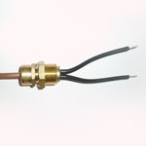
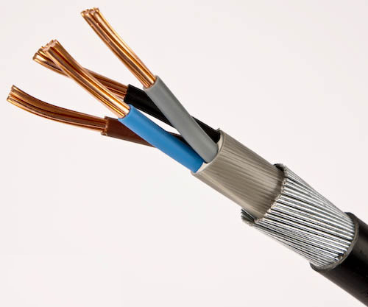
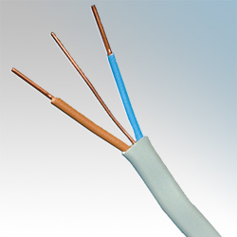
Wiring systems
Clipped direct:
Mineral insulated (MICC)
Steel wired armoured (SWA)
Cross-linked polyethylene (XLPE)
Polyvinyl chloride/polyvinyl chloride (PVC/PVC).

Slide 4
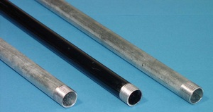
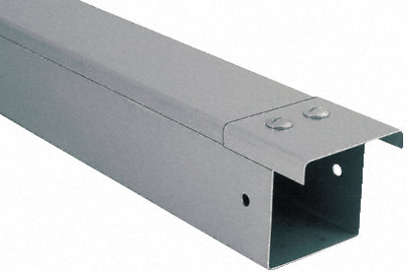
Wiring systems
Steel conduit and trunking:
generally used to deliver single core cables in industrial, commercial and health settings
strong and able to resist high mechanical stresses.

Slide 5
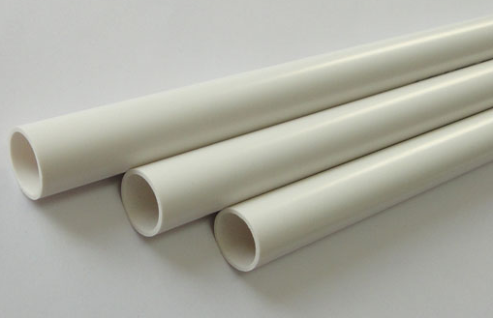
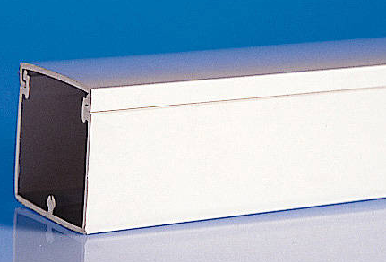
Wiring systems
Plastic conduit and trunking:
as with steel conduit and trunking, single core cables are generally installed in schools and commercial premises.
less robust than steel conduit but easier to install.

Slide 6
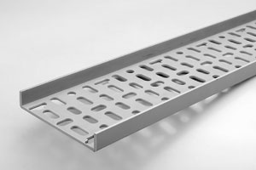
Wiring systems
Cable tray:
commonly used to support a number of cables where individual clipping is difficult or not economical.
tray is used either above ceilings or in industrial or commercial settings.
it has a range of sizes from 50mm to 1,000mm.

Slide 7
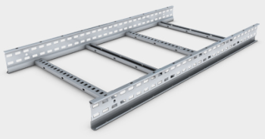
Wiring systems
Ladder rack:
similar to cable tray but with greater strength and used in industrial settings to deliver large numbers of sub-main cables.

Slide 8
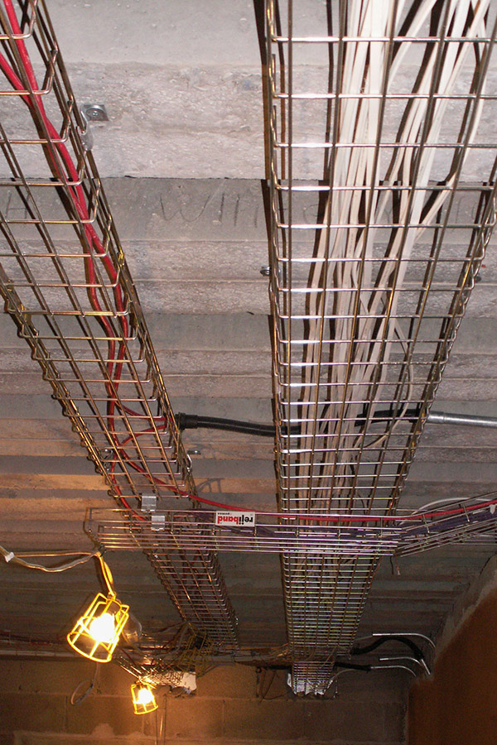
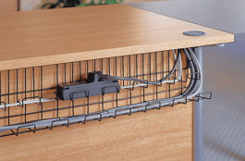
Wiring systems
Basket tray:
similar to cable tray but more likely to be used in commercial premises for large amounts of smaller cables.

Slide 9
Unit 203: Electrical installations technology
The End

